Slide 1
PhD presentation
Cultural history of training forms (Kata) of Far Eastern self-defense martial arts
Edvard Šefer

Slide 2
DOBRODOŠLI VSI
WELLCOME EVERYONE

Slide 3
INTRODUCTION
In my research, as her title suggests, I devoted myself to Kata forms therefore I have to explain at first what kata forms are, what is Kata purpose and how Kata are performed because according to my research and to my opinion Kata are not understood or mostly understood wrong.
Kata definition by Jones is: “This Japanese concept identifies a prearranged, or choreographed, activity in which the basic techniques of a certain fighting style are acted out by one person. This is typical and wide spread, common and completely wrong understanding of Kata, because there is no pre-twentieth century Japanese Kata, all original Kata have Chinese roots, there is no choreography which was introduced in the twentieth century, fighting styles occurred out of not knowing original martial art, Kata does not contain basic but advance techniques.
Kata are not for fighting but for self-defense.
Kata training forms are performed as their poetic name tell as dancing in the fields and Hokama stated that Kata come from Okinawan dances. I strongly disagree with this statement. Kata did not come from dances but Kata was transformed to dances due to the ban on training. Same happened with Capoiera and Angampora. In this dance trainee walk mostly forward, backward, left and right to come from starting point mostly back to starting point. During walking he move hands and legs in several forms and release screams .

Slide 4
RESEARCH QUESTIONS
At the beginning I set to me following questions:
What is the purpose of Kata?
When did Kata appear?
Why did Kata appear?
For whom were Kata created for?
When did Kata perception of the art of self-defense change into the sport of strong men?
What credible historical sources confirm my theses?

Slide 5
After researching philosophical and historiographical literature, participating in courses of other masters, my own teachings, analyzing works of art, and graphic material, I set the following hypotheses:
- Kata is intended for self-defense of a weaker person (women).
- All original Kata in the White Crane style were created by Chinese or perhaps Okinawan masters from the sixteenth century onwards.
- Kata was created because ordinary people of Okinawa were completely powerless under Japanese invaders due to the ban on carrying weapons and practicing martial arts.

Slide 6
LITERATURE
Here I faced to my biggest research problem. There is no much written on this subject. I tried to find historical documents but there is nearly no historical documents because carrying weapons and training martial arts (including literature on this subject) was banned on Okinawa from 1477 to 1868. Even acclaimed martial arts historian Patrick McCarthy explains how “credible pre-twentieth century documents explaining the history and evolution of Karate are virtually non-existent”. The only books on which I could rely and with which I could later compare my findings are general Qi Jiguang Jixiao Xinshu military manual written in 1561 and the twentieth century Bubishi book editions. Even so, I found and read more than ninety books and fifteen articles that are in direct or indirect connection with my research.

Slide 7
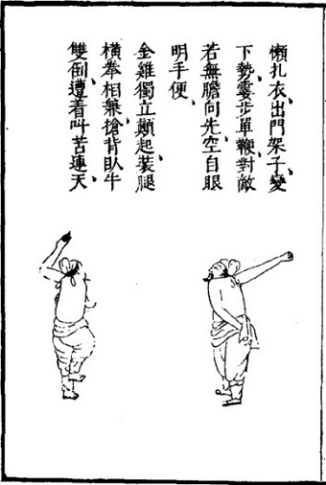
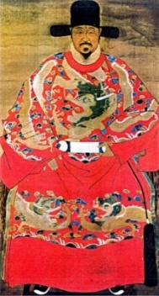
Qi Jiguang and his Jixiao Xinshu
Out of his dress we can see that Qi Jiguang was very important man he was dressed red that was allowed only to high officials with ornaments of golden dragons presenting his imperial power and authority and with peacocks presenting his power and protection.
Jixiao Xinshu contains 32 posters of a fighter with the accompanying text written in verses full of symbols which I manage to explain them all. It is especially important that Qi Jiguang wrote that these posters are meant for those who cannot be strong. This is the first written and non‑disputable confirmation that Kata were made for self-defense of weaker persons.

Slide 8
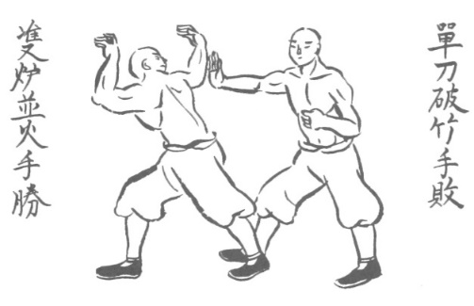
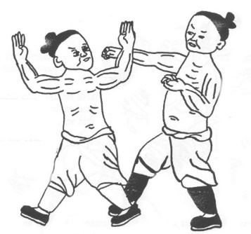
Bubishi
Gathering around a fire.
Breaking bamboo.
Bubishi editions mostly have 48 drawings with accompanying text in a language full of symbols. This book is based on the notes of Okinawan students who studied in China around 1850. There are several different editions that differ from each other in small but important details. Even so I succeeded to decode all 48 poster. For my study I used edition from Patrick McCarthy, The Original Fu Roku Bubishi by unknown author and Nisan David S., Kangyi Lui. The general Tian Wubezhi

Slide 9
RESEARCH METHODOLOGY
For my research I used methodology rules for researchers set by Descartes:
doubt everything and to consider true only that which is unquestionable;
divide the problem into several simpler parts;
start with smaller problems and move to more complex ones;
check several times to see if you have missed anything.
I doubted all Kata explanations. I was as British historian K. Jenkins proposed a “disrespectful researcher” of the past and largely violated Japanese Giri’s principle spread and applied between Karate practitioners. Giri severely limits any and all research because of its limitations (“serving superiors with sacrificial devotion”), Because of Giri, it is not polite to ask Japanese masters anything therefore I could not conduct interviews. No much difference is with western masters.

Slide 10
I used qualitative method with goal to gain a human understanding of martial arts and consequently an understanding of Kata, here I must remark that I studied only pre-twentieth century Kata forms with no interest for modern sport versions. I started collecting data by learning Kata (San Chin, Taykioku, Nai Han Chi, Jion, Shimpha, Bassai, Hangetsu, Wu Shu, Chinto, Chite, Sun Su, Sei San, Seienchin, Kin Ken…) in all versions I found on YouTube and continued with the method of participant observation and collecting data by attending seminars around the world.
I even created my own Kata with the name Uke that contain basic actions that every beginner learn at first. In order to devote myself to independent comparative research on a physical level, I founded my own club in 2008, where I was able to test my own findings on my students. Based on research in 2009 I wrote the first edition of the book In Kata is everything you need.

Slide 11
I made semiological approach to paintings, drawing and texts to enable me to understand them and I used content analysis focused on written and visual objects, and the repetitive patterns present in them, relying mainly on indirect information, as Kata, texts, and drawings are made in a way that is incomprehensible to “ordinary” observers. By doing so, I devoted myself to conceptual analysis. I did not want to take on sport dogmatic explanations, and because no one had done this type of epistemological research yet, I had to use another knowledge. Therefore I used philosophy as the basis of my research in order to understand the spirit of the nation; history to understand the spirit of the time; kinesiology, in order to understand the motor abilities of the human body; acupressure, to understand – how to weaken or incapacitate attackers’ body and physics and mathematics, to figure out through mechanics and vector analysis how the weaker could tame the stronger. Only after applying all these knowledges I was able to undertake a detailed observation of Kata’s own speech.

Slide 12
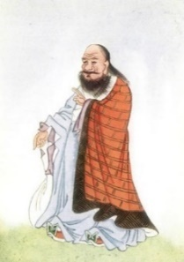
CHINESE PHILOSOPHY - the first foundation for research
Kata were created in China, therefore I looked for wise men from Chinese history – Chinese philosophers. China, philosophy is different than western philosophy and is based on wisdom collected by wise men who spread it in the form of mysterious sentences or proverbs that transpose certain kernels of wisdom that they have found.
I will start with Lao Tzu wisdom. He was the founder of Daoism and lived about 2.500 years ago. His most important wisdom is that the highest level of fighting is no fighting.

Slide 13
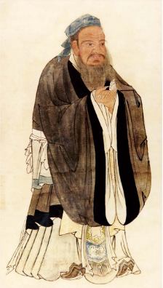
Confucius (551‑479 BC) wisdom: You cannot open a book without learning something helped me not to give up my research.
I found in his wisdoms for me the most important research method: If I am walking with two other men, each of them will serve as my teacher. I will pick out the good points of the one and imitate them and the bad points of the other and correct them in myself.
His wisdom explained me which solution is the right one: Life is really simple, but we insist on making it complicated.

Slide 14
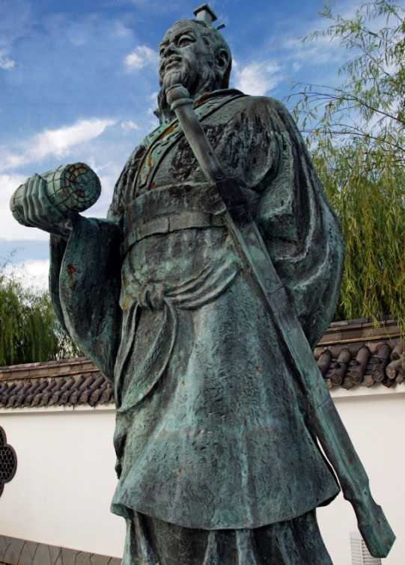
Sun Tzu most important Chinese philosopher for martial artists
Sun Tzu wrote about 2.500 years ago the book Art of War. This Book contains important instructions for Kata research.
The most important two wisdoms are: “In ancient times, an experienced warrior first assured his own invulnerability and then waited for the enemy’s vulnerability.” and second “A skilled warrior attacks so that the enemy cannot defend himself and defends himself so that the enemy cannot attack.”

Slide 15
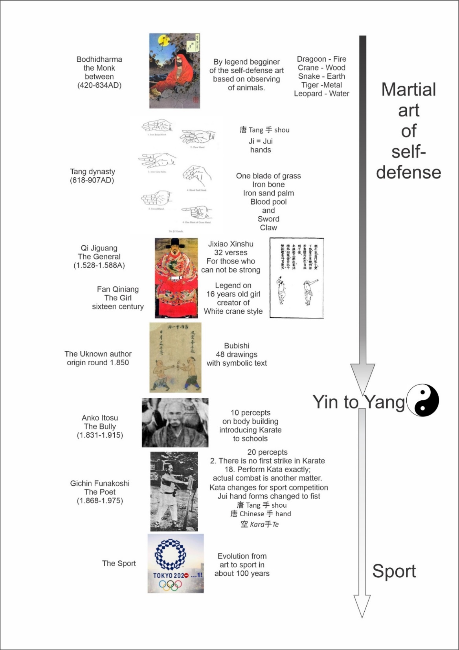
HISTORY
Confucius wrote “Study the past, if you would divine the future,” and Johan Wolfgang von Goethe wrote “history of a science is that science itself” that's why I studied life of important persons from martial art history.
Martial art history started with Bodhidharma 1500 years ago and finished with 2020 Olympic games in Tokyo.

Slide 16
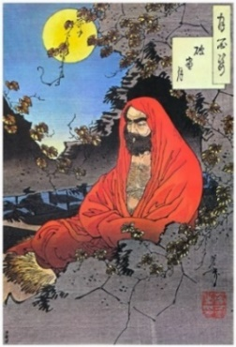
Bodhidharma
By legend Martial art hidden in Kata started with Bodhidharma (enlighten person on right way) who come from India to Shaolin monastery about 1500 years ago. There are doubts about his existence and that legend on him arose out of Chan Buddhist school’s need to have direct connection with Buddha. I speculate that there were several Bodhidharmas, because there are legends on him in China, Indonesia and Japan and this could be to much for one person life time. My most important conclusion is that according to that what Buddha was teaching Buddhist monks could not be aggressive and therefore must be that Bodhidharma thought self-defense art that was later transformed to aggressive art. He was with no doubt well educated for his time and he was well observer. During his voyages he was observing natural circular moves of the farmers and animals how they hunt and incorporated observations in his martial art. Important is the legend of the origin of the martial art Silat, which he is said to have brought to Indonesia. The legend says that this style of self-defense was created by a woman when she observed a fight between a snake and a crane, and then used it to protect herself from her violent husband. There is very similar and more known legend on Fang Qiniang

Slide 17
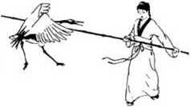
Genaral Qi Jiguang and Fang Qiniang
Qi Jiguang during his 10 years stay in Fujian, had master instructors who thought commoners self-defense recoded in his Jixiao Xinshu. From the need to convince ordinary people to start training these martial art, the legend of Fang Qiniang arose. She was a sixteen years old girl leaved in Fujian at that time. She learned martial art from her father who was martial artist. By legend she observed how White cranes are fighting and based on observation created White crane style.
Out of this legend there are two important facts for my research:
Suitability of this martial art for woman and that it stems out from animal fights.

Slide 18
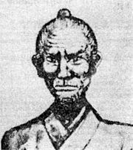
Okinawa
In 1609 Japanese invaded Okinawa and harsh time for Okinawan people occur. Japanese continued in 1447 introduced ban on carrying the weapon and training martial art until 1871. During this time, Kata training began out of the Okinawans' need for unarmed defense against the Japanese. This was possible because Kata was able to train as a dancing in the rice fields. Okinawans kept in secrete knowledge hidden in Kata forms and never reveal it to Japanese. Japanese were only able to observe how Okinawans danced and to copy them. Thanks to coping Japanese preserved Kata forms for us but knowledge was lost and that made a base for turning martial art suitable for woman to something for strong man. According to my research the last who really knew complete art was Matsumura Sokon the bodyguard of two Okinawans kings. He died somewhere between 1890 and 1901.

Slide 19
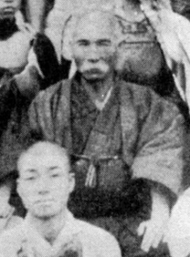
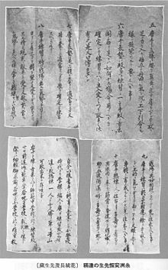
Anko Itosu
Ankō Itosu was born in 1831, and died 1915. I find him as most responsible person for turning Martial art suitable for woman to something for strong man. He is famous because of his ten percepts on Karate (1908) with which he convinced Japanese authorities to introduce Karate to schools.
According to my perception his percepts are nothing else than body building advertising and explanation that karate is good for health and that's why he was so well accepted by authorities because Japan was preparing for war and they needed strong and healthy soldiers.

Slide 20
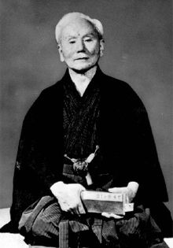
Gichin Funakoshi
Giching Funakshi (1868-1957) was most significant person for karate spreading in Japan and he made final step in Kata transformation from Martial art to sport. He changed the name of the martial art from “Chinese hand” to “empty hand,” by switching the Japanese characters with the same pronunciation: 唐 Kara手Te, where Kara means “China” and Te means “hand,” with 空 Kara手Te, where Kara means “empty” He did not know that the Chinese pronounce this characters as 唐 Tang 手 shou where Tang means the Tang dynasty (618-907) and shou means hand and that Tang shou is original name of this martial art. He wrote twenty percepts on Karate. The most important is second where he says : There is no first strike in karate; confirming that Karate is art of self-defense. The most disappointing is his eighteen percept where he says: Perform Kata exactly; actual combat is another matter. With this percept and the fact that he changed performance of several Kata to look nicer and are more suitable for evaluation on Kata tournaments, I can say that he did not know the value of Kata.

Slide 21
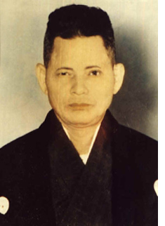
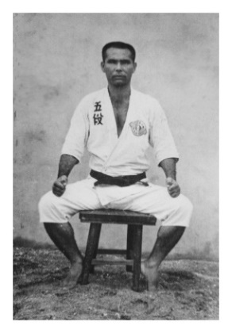
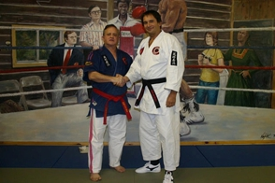
Other for my research important my era masters.
Tatsuo Shimabuku (1908-1975) He left behind from end of fifties and beginning sixties 8mm movies where he present Kata in original form so different than nowadays performance and this helped me enormous to start understanding what is what. (first Kata tournament was held in Tokyo in 1958)
Taika Seiyu Oyata (1930-2012) Who brought basic knowledge on using of acupressure points to western world.
George Dillman a four-time National Karate Champion in the U.S.A. and pupil of Oyata.
Great researcher who wrote several books on Acupressure points use in Martial art and my teacher without whose knowledge I would not have been able to began my research at all.

Slide 22
THE FUNDAMENTS FOR KATA UNDERSTANDING
We have to start with my mentor definition that self-defense is a technical and tactical skills to avoid or fend off an attack, and neutralize the attacker. To start understanding it is important to accept that martial art is fighting skill with no limitation as present in combat sports where Agon and Ludus are applied. Agon is equality of fighters. Ludus are rules that protect fighters from injuries and prolong fights.
Basic fundament is the first Kata in White crane style which are Qi Jiguang 32 posters that are still performed like Kata in China by Kung Fu masters.
To understand Kata it was important to approach to them from Cultural history stand point. Maybe most important was Malinowski stick theory telling that stick have different meaning in different cultures and Herman saying that to derive meaning from material culture we must reconnect objects to their historical context. Important was Cartier writing on how important is to know how elite of particular society understood the world and how mases follow the elite.
We have to be aware that there is no three sorts of kata (vinto for sight, hyöen for exercise, and rentan for energy) as defined by Lind in his book Lexikon der Kapfkunste. Such approach is complete ignorance. There is no magic in Kata as Jones wrote there are only advanced techniques not understandable, or detectable by any commoner’s observation. Kata explanation given in modern era Karate books are naive and have no connection to real purpose.

Slide 23
The masters incorporated what they saw and knew into the art of self-defense hidden in Kata. They incorporated:
Peasants everyday natural moves learned unconsciously which are perfect circular moves spending the smallest energy to do the work.
Five elements of Chinese philosophy teaching how to stimulate or how to knock out attacker by attacking energy channels in human body. This five elements can be presented trough five animals where it is important to understand philosophical meaning of five animals explaining how predators tiger and leopard are hunting, why dragon is invisible and how to behave as dragoon to be invisible, why snake bites so fast and how human can apply same technique, why crane is so stabile standing on one foot and how human can achieve same stability,

Slide 24
Six Kata rules
Based on my research I set six rules how Kata are constructed and proved this rules trough Kata Bunkai.
Applying this Kata rules in Kata construction research tells exactly if Kata is original old Kata or something created in twenty century.
First is Shogun rule that teaches as Funakoshi expressed that there is no first strike in Karate.
Second rule teach how in six steps execute self-defense by redirecting attacker energy, steeping in his inner space, positioning behind his body, striking acupressure points, breaking attacker extremities and killing.
Third rule is teaching to use attackers force.
Fourth rule is teaching to use body characteristic - kinesiology
Fifth rule is teaching to stay out and not to interwind with attacker
Sixth rule is teaching how to use emotions to confuse attacker.

Slide 25
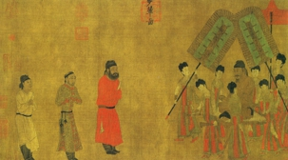
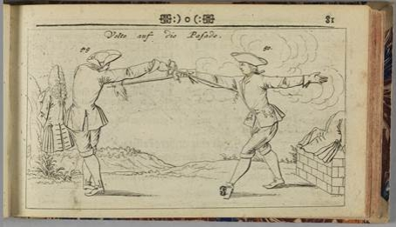
HISTORIC OBJECTS AND RELIABLE SOURCES PROVEING THAT KATA ARE MADE FOR SELF-DEFENSE
The only 100% reliable source is Jixiao Xhinshu and quiet good source are Bubishi book editions.
Before I started to understand I had to be aware about stick theory and that why I studied Chinese mythology to understand what does in Chinese mythology mean plum blossom, carp leaps the falls, giraffe and many other words.
Second was to learn how to observe Chines drawings and Chinese martial arts drawings. Both of them have to be observed very precisely, because painters tried to tell as much as possible about event or person on the drawing, besides that it was very important to come to conclusion that martial art drawings show in the most time fighters in most important position but not in same moment as we are used in western instructional books.
Chinese painting from seventh century
European drawing dated between 1400 and 1600

Slide 26
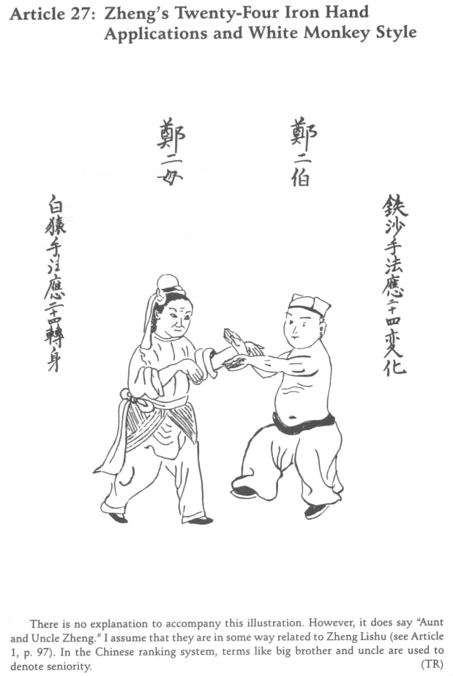
Bubishi example
Aunt and Uncle Zheng are fighting. Zheng can be understood as a family name but symbolic explanation is attack. Term “uncle” is used to denote seniority telling that this self-defense is suitable for senior people. There is “iron hand” what mean that someone is using an iron hand (metal), and metal energy is always used against wood pressure points. On the drawing is the Aunt Zheng in a position closer to the observer. This means that we have to focus on Aunt Zheng. Aunt Zheng has stripes on her forehead (scars) and her lips are turned down (she is angry). Uncle Zheng does not expect any resistance, and is still smiling. Aunt Zheng is dressed well, from a noble, wealthy family, educated and has the knowledge of martial arts. Uncle Zheng is dressed in trousers with a sailor’s hat, showing that he is just some poor drunk creature. His intentions are clear and set with „White Money Style“. Monkey is stilling fruit by grabbing therefore this means that he want to grab aunt Zheng. The Uncle is stepping close to the Aunt. She is diverting his kinetic energy to pass by, using the first defense from San Chin Kata. And finally Aunt place her right-hand palm in the form of the Iron bone hand on the side of the Uncle’s head, on GB20 wood pressure point to knock him out same as in the final action of Shin Pa Kata.

Slide 27
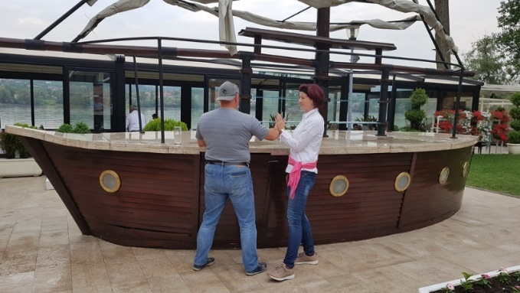
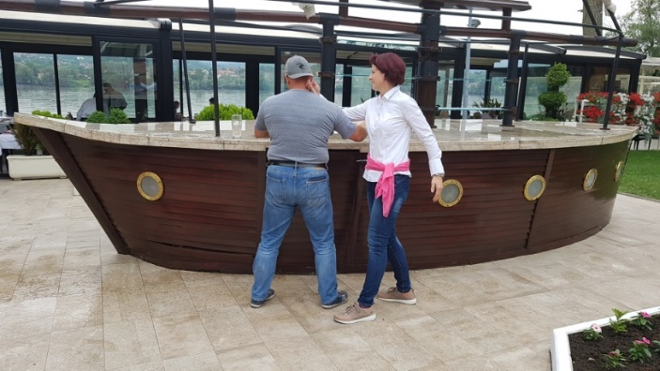
Explanation
Uncle Zheng is approaching Ant Zheng redirect his energy and knock him out.

Slide 28
Jixiao Xinshu Example
When observing Qi Jiguangs posters the avoiding thing is that on one poster there are two verses and two fighters that have nothing in common. First action text tells: “Casually hitch up your clothes and let your body assume the Going out the Door position.” This means that one has to act as being in a narrow place where he has to hold his extremities and his clothes close to his body.” “Change to a lowered posture and momentarily take the Single Whip stance.” This means that one has to prepare his hands for whip. “Respond to your opponent as if you have no courage to advance forward.” This means that you have to place yourself behind the attacker “Vacantly brighten your eyes and ready your hands for convenient opportunities.” This means that one has to focus his eyes to the point where he will place his hit.

Slide 29
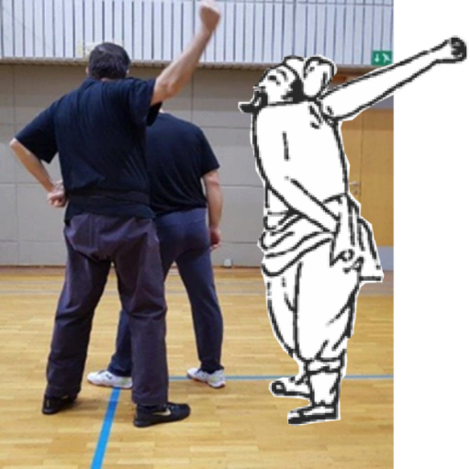
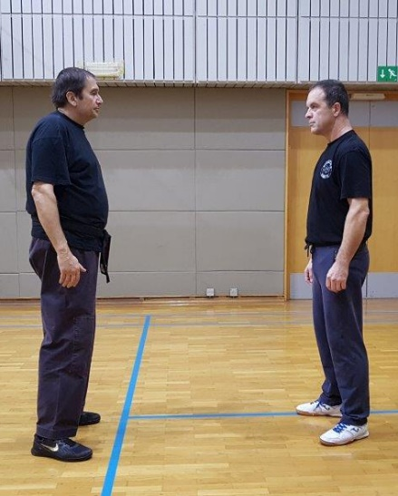
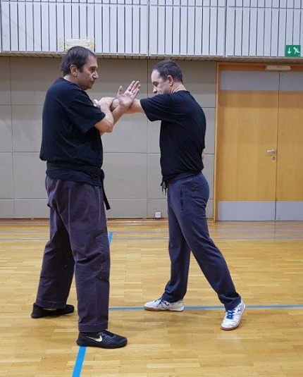
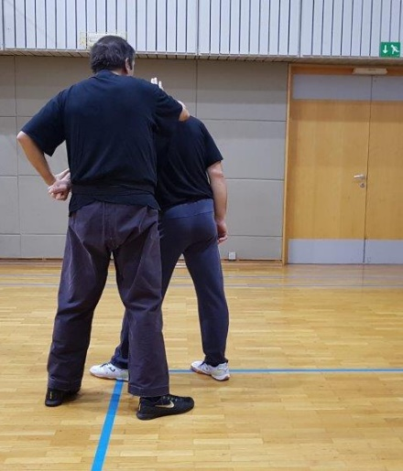
Explanation
Starting position, redirecting attackers energy, going out of the door knock out
and preparing for whip,

Slide 30
CONCLUSION
I think I aimed to confirm the following theses:
Kata contain knowledge that would allow a defender to win.
Kata is intended for self-defense of weaker persons (women).
All original Kata in the style of the white crane were created by the Chinese or perhaps Okinawan masters.
Kata was created out of a need for self-defense because the ordinary people of Okinawa were completely powerless due to the ban on carrying weapons and practicing martial arts.

Slide 31
And I think I got answers to:
A historical aspect when Kata forms appeared. White Crane Kata appeared from sixteen century onwards.
What is the purpose of Kata. Kata were created to practice weaker person self-defense against stronger imaginary attacker.
A social aspect why Kata were created,. Kata developed out of the need for Okinawan people to defend themselves from Japanese occupier.
A logical aspect for whom Kata were created. Kata were created for common people.
When the perception of Kata turned to something for strong men. Kata turn happened end of nineteen and beginning of twentieth century.

Slide 32
Thank you for listening and if anybody would like to discus details he can find me on sefer@siol.net

